Slide 1

RooMatch
Represented by: Arkadi Doktorovich, Elia Meerson

Slide 2
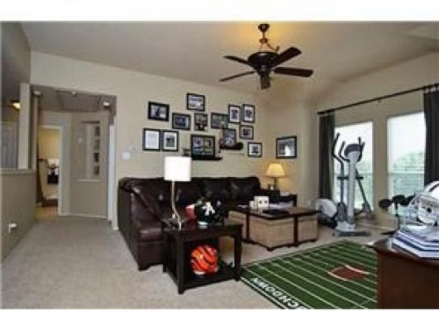

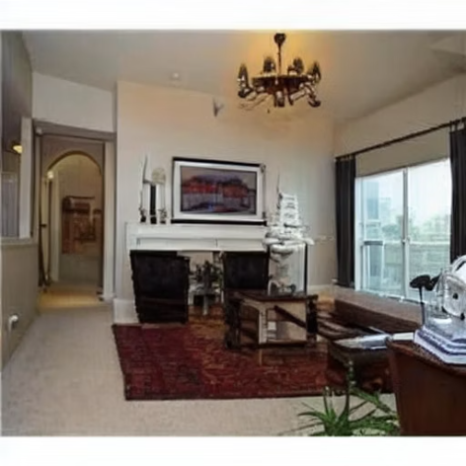

Room Image Retrieval
Matching images of the same room is challenging due to visual variations. We address this using embedding based image representations and similarity in a learned feature space.
Real Image:
Generative Target Synthetic Image:
Project Goal
The goal is to learn image embeddings that enable reliable retrieval of images of the same physical room. Images are ranked by embedding similarity.
Novelty
We created a synthetic room image dataset with multiple variants per room, changing lighting, decor, and movable objects while preserving room identity. This enables systematic evaluation of exact room retrieval, a task for which no public dataset currently exists.

Slide 3
Recent Advances in Visual Retrieval
Recent work studies embedding-based retrieval for identifying the same physical space. Our project evaluates room-level embeddings using synthetic data and Recall@K metrics.
work/year
Task
Method
Dataset
Results
Relation to
our project
Breaking the Frame: Visual Place Recognition by Overlap Prediction
Visual Place Recognition (retrieval under partial overlap)
Predicts visual overlap using global embeddings extracted with ViT (DINOv2) and overlap-based scoring
Large-scale outdoor VPR benchmarks
Improves retrieval accuracy when images share only partial visual content
Uses global embedding-based retrieval as a baseline and analyzes its limitations.
2025
AirRoom: Objects Matter in Room Re-Identification
Room Re-Identification (instance-level retrieval)
global embeddings followed by object-level matching and aggregation
MPReID, HMReID, ReplicaReID
Achieves state-of-the-art room re-identification performance
focuses on retrieving images of the same physical room using embeddings
2025
Patch-NetVLAD: Multi-Scale Fusion of Locally-Global Descriptors
Visual Place Recognition / Image Retrieval
Embedding-based retrieval combining global image descriptors with local patch aggregation
Pitts250k, Tokyo24/7
Outperforms global descriptors by incorporating local information
Supports embedding-based retrieval for identifying the same place, aligning with our room matching approach
2020

Slide 4
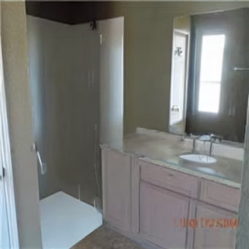
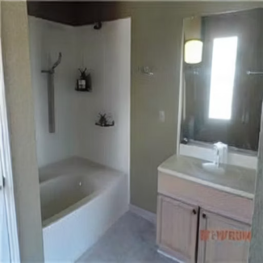
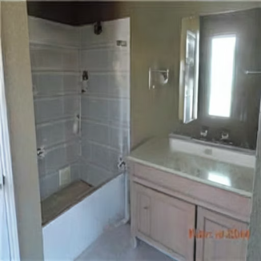
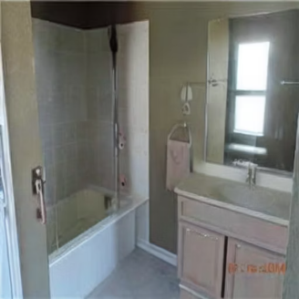
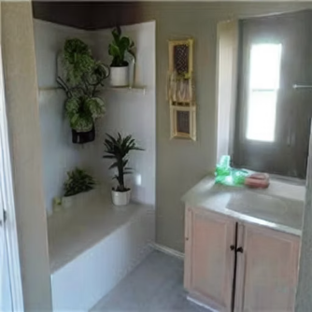
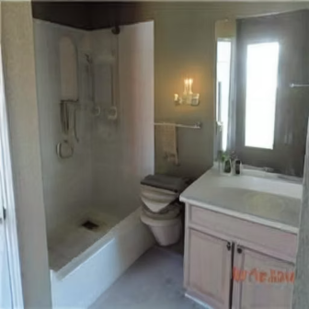
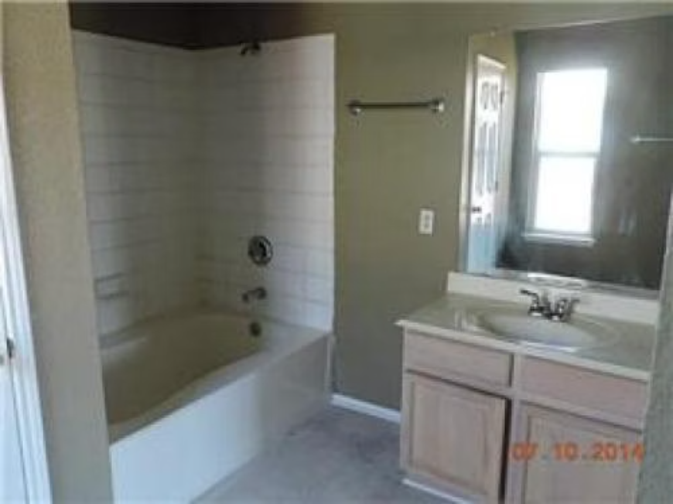
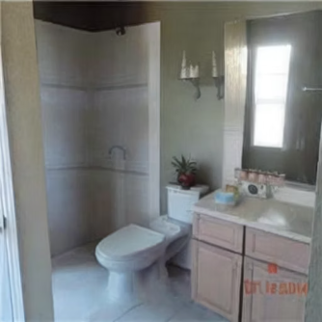
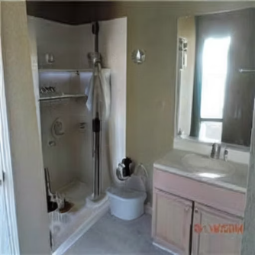
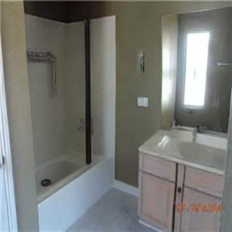
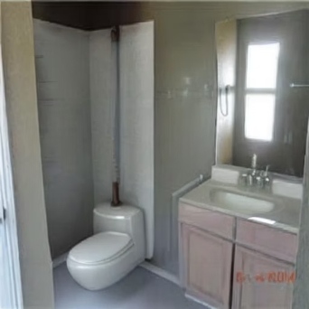
Dataset Example:
Generated Synthetic Images:
Real Image:

Slide 5
Room Matching Dataset
Dataset Description
Data Labeling
Dataset Preprocessing
The dataset contains 50 real room images collected from various sources.
Room attributes include lighting, rugs, curtains, wall decor, plants, and clutter.
Images are processed through a PyTorch Dataset class.
For each real room image 10 synthetic variants were generated with Stable Diffusion V1 to increase diversity while preserving the same room layout.
BASE_PROMPT - ensures the same room geometry is preserved while decor, lighting, and movable objects are varied.
Each image is resized and center cropped to 224×224 pixels.
Images are normalized for DINOv2 embeddings.
NEGATIVE_PROMPT - prevents generating entirely different rooms or altering the room layout.
The dataset provides image tensor, room ID, and index for embedding computation and evaluation.
Each image is assigned a room ID, which acts as the ground truth for evaluation.

Slide 6
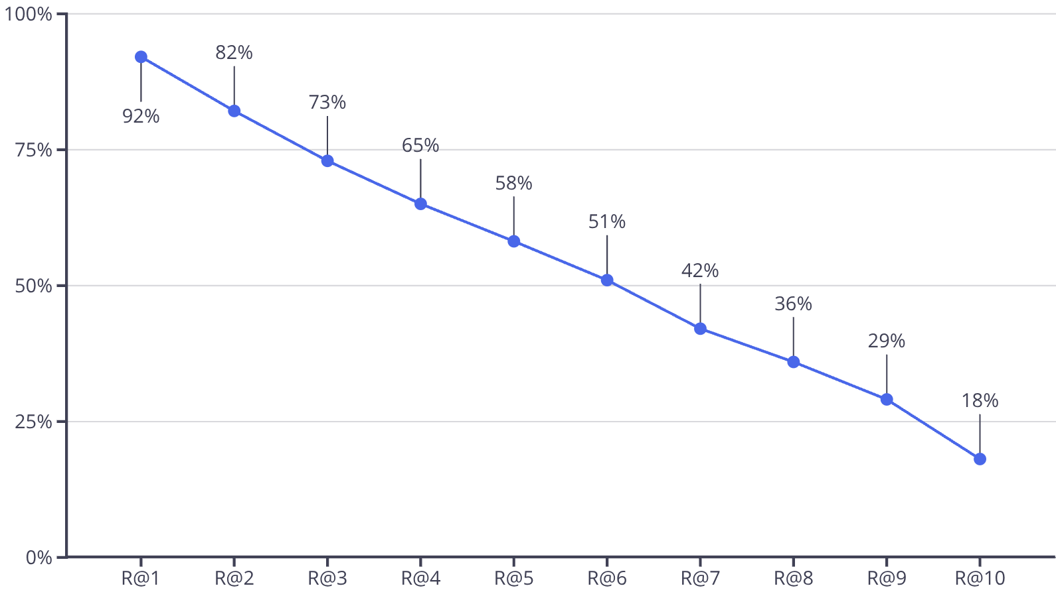
DINOv2 Embeddings and Retrieval Evaluation
Baseline Model
Evaluation Protocol
Pretrained DINOv2 Vision Transformer used as a fixed embedding extractor
Task: Given a query image, retrieve the most similar images
No fine-tuning or task specific training (zero shot)
Ground truth: images with the same room ID
Each image is mapped to a 768-dimensional embedding
A query is counted as correct only if all top-K retrieved images belong to the same room
Embeddings are L2-normalized (equally long)
Cosine similarity + k-nearest-neighbors used for retrieval
Error Analysis
Prompts that are too weak result in nearly identical images.
Prompts that are too strong may unintentionally alter the room identity.
Even a single poorly generated synthetic image can cause Recall@K to fail.

Slide 7
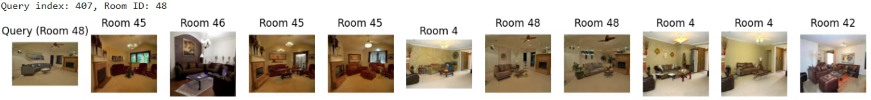
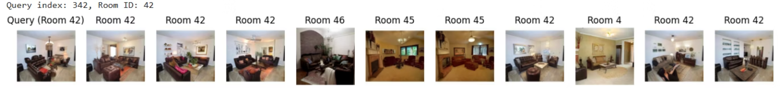
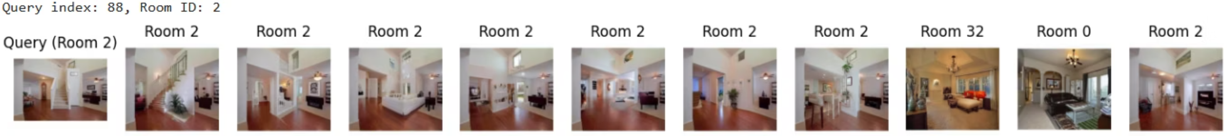
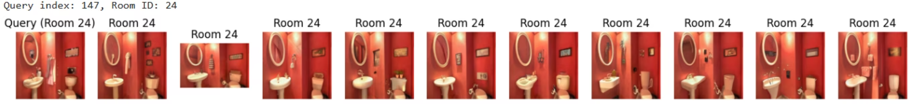
Result Examples:
Recall@0 (failure):
Recall@3:
Recall@7:
Recall@10:

Slide 8
Project Plans
Step
Description
Deadline
Expected Outcome
Prompt Optimization & Testing
Design and Test different prompt strengths and attribute combinations to balance visible changes and room identity preservation.
week 10
Stable prompts that consistently generate diverse yet identity preserving room variants.
Data Creation
Generate synthetic room images using diffusion models and assign room IDs inherited from the original images.
week 10
A balanced dataset of ~11,000 images with multiple visual variations per room.
Model
Fine-Tuning
Train with room ID based positive and negative pairs so that images of the same room have closer embeddings, while different rooms are pushed apart.
week 11
Improved embedding space where images of the same room cluster tightly, leading to higher Recall@K on unseen images.
Evaluation & Analysis
Evaluate the model by measuring how well its embeddings retrieve images of the same room using Recall@K.
week 11
Gain insights into errors caused by visually similar rooms, generation artifacts, or outlier images.
Prepare Final Presentation
Summarize methodology, results, and findings. Visualize retrieval examples and evaluation metrics.
week 12
Clear and well structured presentation communicating the project’s results.

